Slide 1

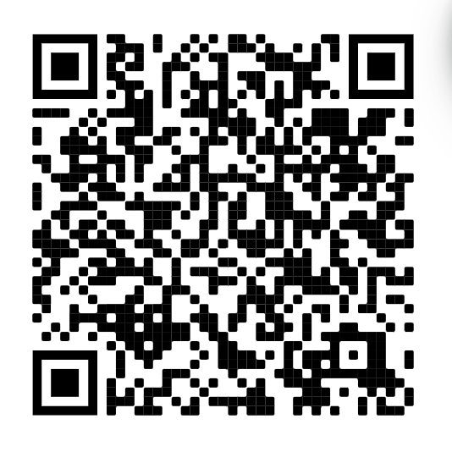
Sign in! —>

Slide 2
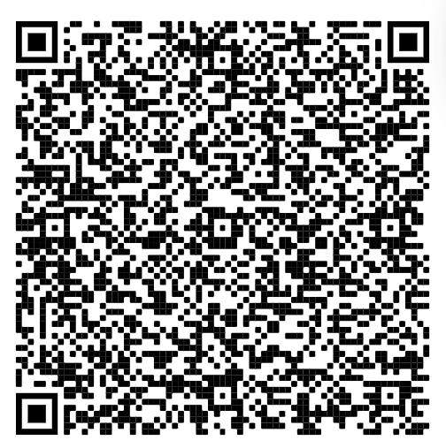
Quick things:
Tentative WiCS Formal Date: Friday, November 11th (probably around 9pm)
Vote your favorite theme!

Slide 3
And now…
Mentorship Assignments!
Drumroll please>>>>>

Slide 4
Mentor- Mentees
Maanya Shanker-Morgan Wessner, Ruchi Hegde
Richa Desai- Delaney Scheidell, Grace Hines
Nikhita- Brooklyn Castleberry, Anne Norris
Lucy- Ellie Tishler, Alexa Mckee
Stella- Ly Nguyen, Zeana El-Hajomar
Caela- Yu Lin Lu, Dorothy Crow
Shreya- Kiana Kazemi, Laiba Awan
Allison- Maia Harmon, Johanna Luke
Anita- Grace Sweeney, Danielle Paton
Madeline- Sapna Desai, Kruti Karnik
Aditi- Nina Southern, Michelle Hong

Slide 5
We will have time at the end to meet your mentors and exchange digits and stuff
We’re gonna try to do a brunch event so you can meet your mentor-mentees so keep on the lookout for that

